Slide 1


Multi-Tenant SaaS Billing & Usage Analytics Platform
“A Scalable Backend Built with FastAPI,MongoDB and Docker”

Slide 2
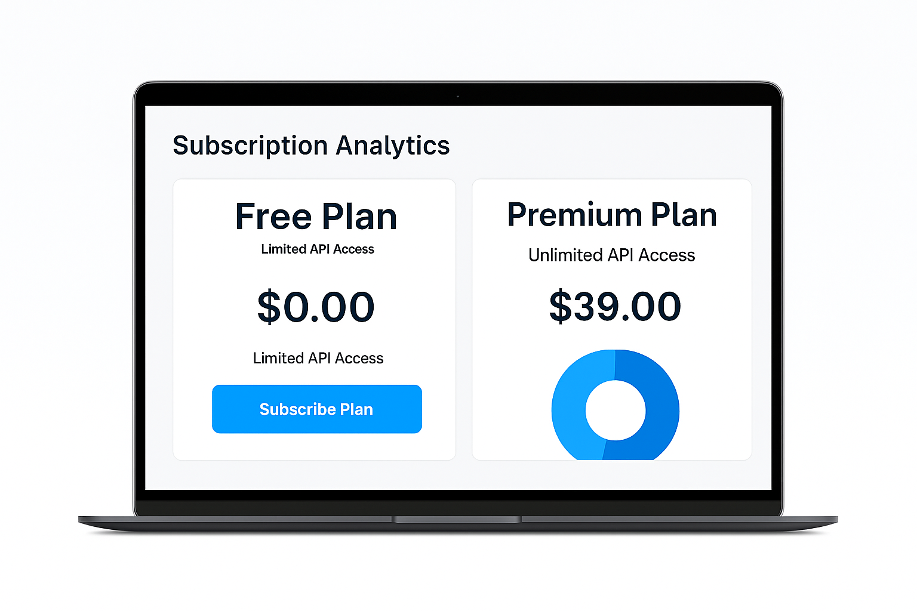

Multi-Tenant SaaS Billing & Usage Analytics Platform
Image here
Scalable SaaS platform for subscription billing and usage analytics.
Built with FastAPI, MongoDB, and Docker.
Supports tenant management, plan upgrades/downgrades, usage tracking, JWT-based authentication, and efficient async operations.
SaaS Billing & Analytics System

Slide 3
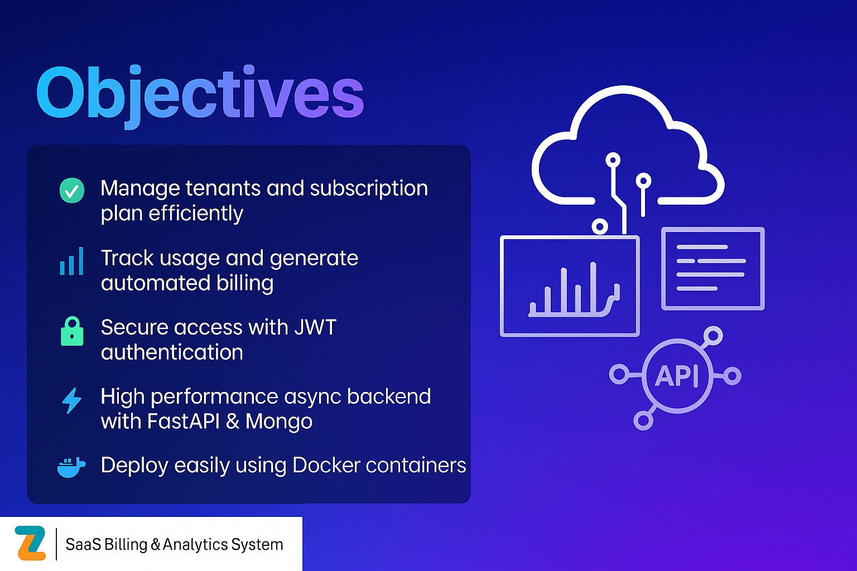

Slide 4
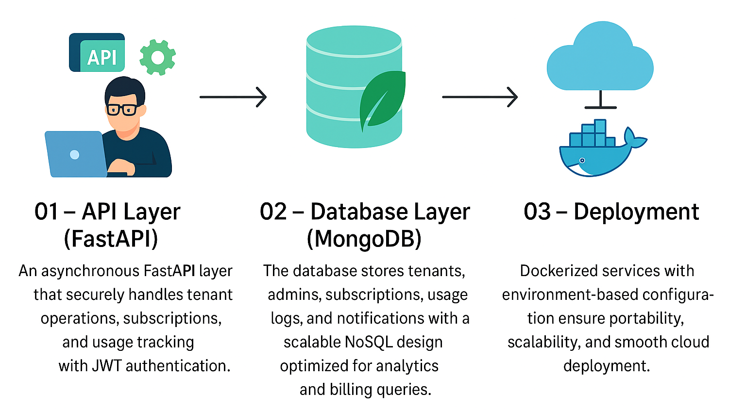
Architecture
SaaS Billing & Analytics System

Slide 5
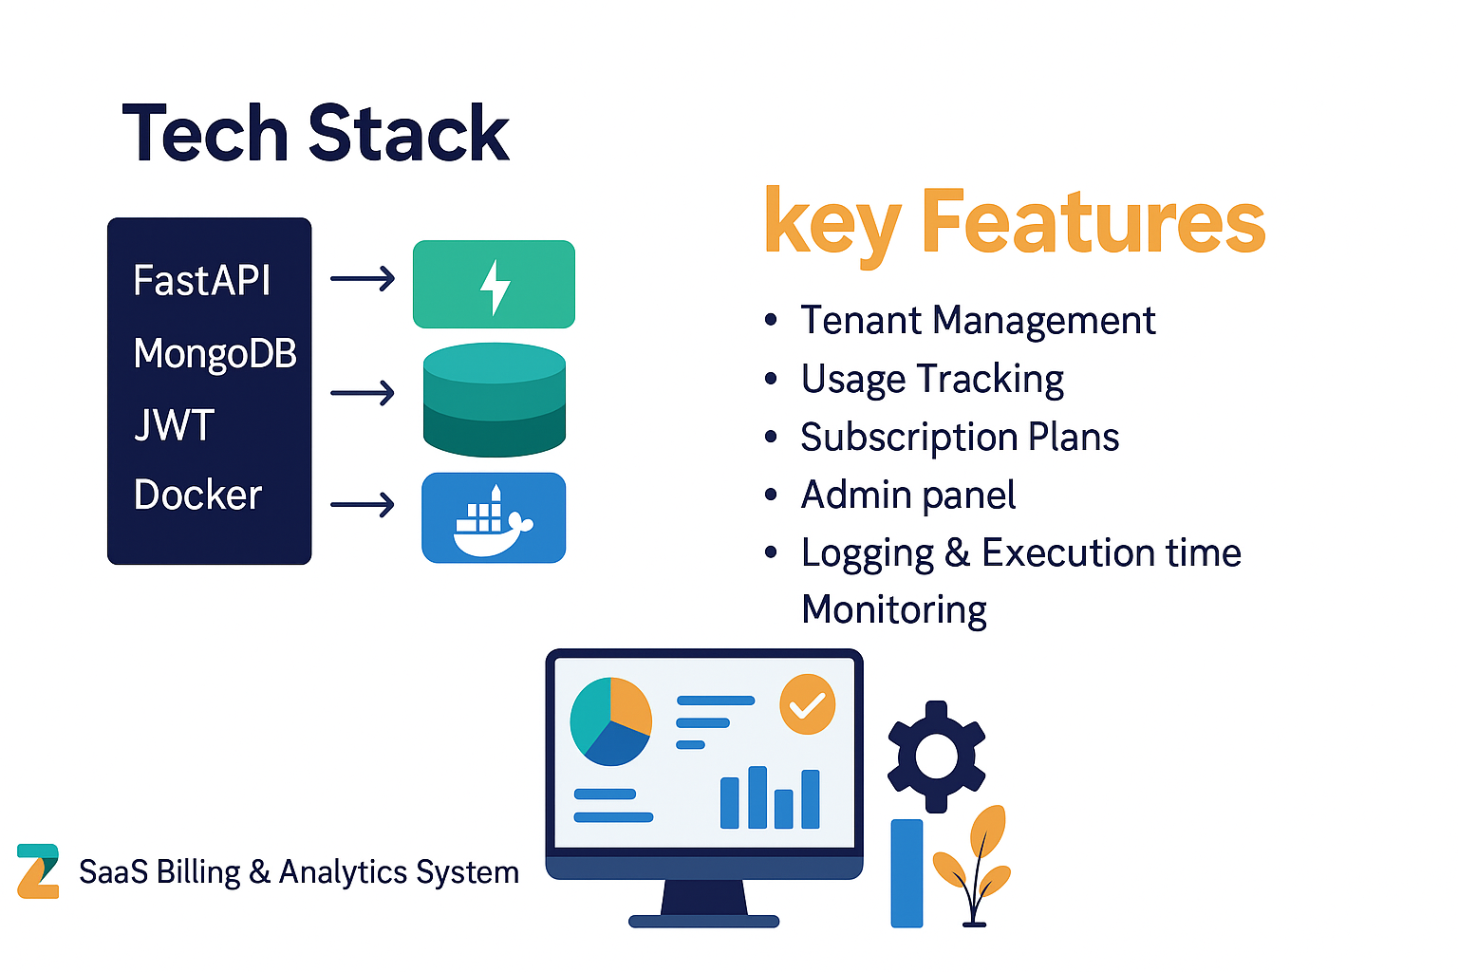

Slide 6
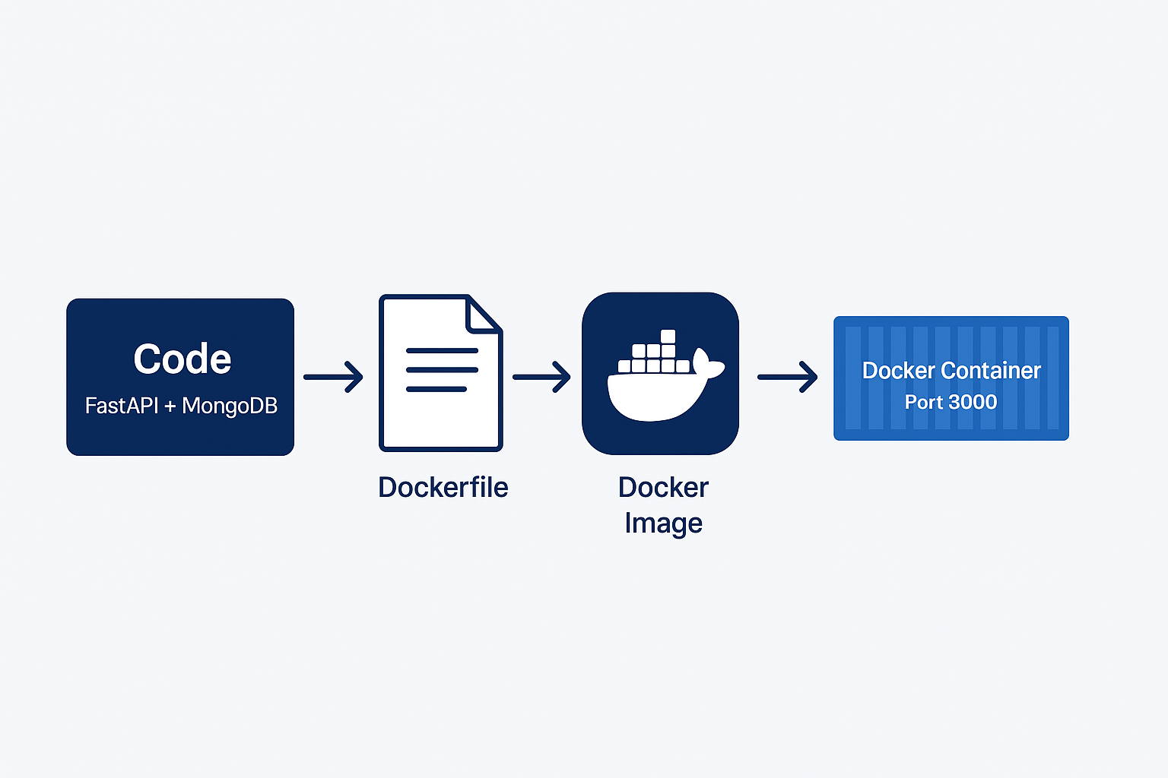
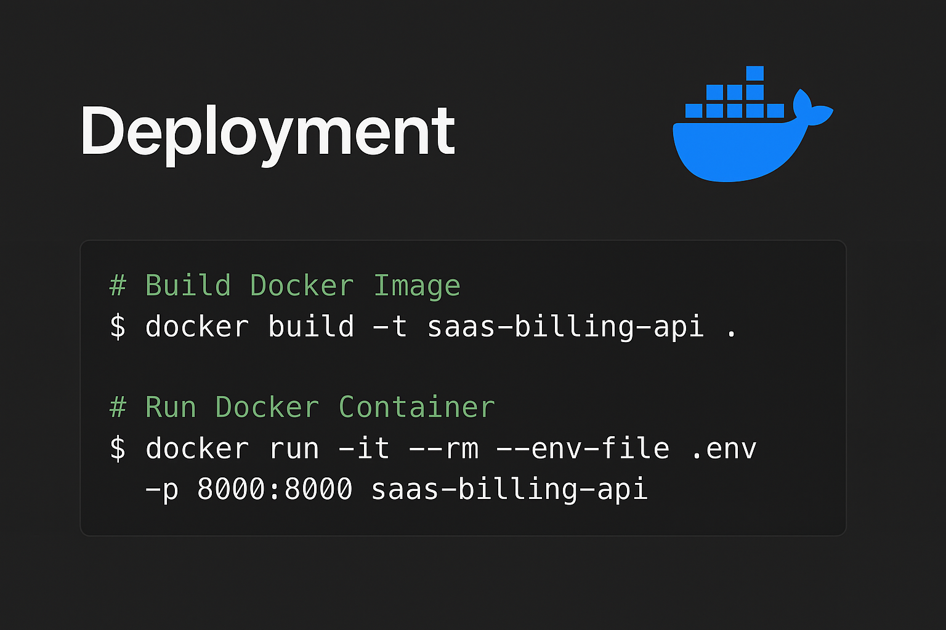
Deployment (Dockerized FastAPI App)
Packaged FastAPI app using Dockerfile
Runs as a container with uvicorn on port 8000
MongoDB URI provided via environment variable (MONGO_URI)
Easy to run anywhere using:
Ensures portability & consistency across environments
SaaS Billing & Analytics System

Slide 7
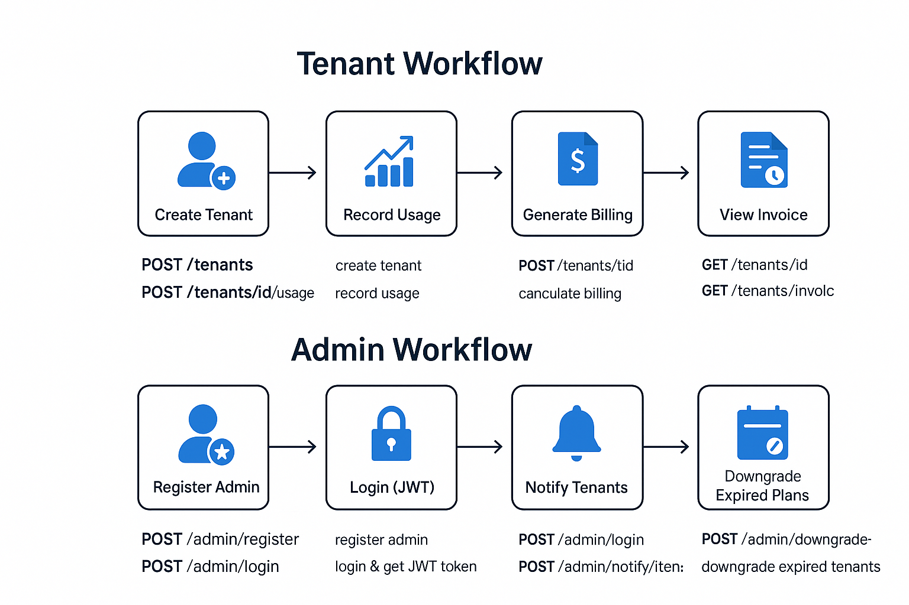
System Workflows: Admin & Tenant Operations
SaaS Billing & Analytics System

Slide 8
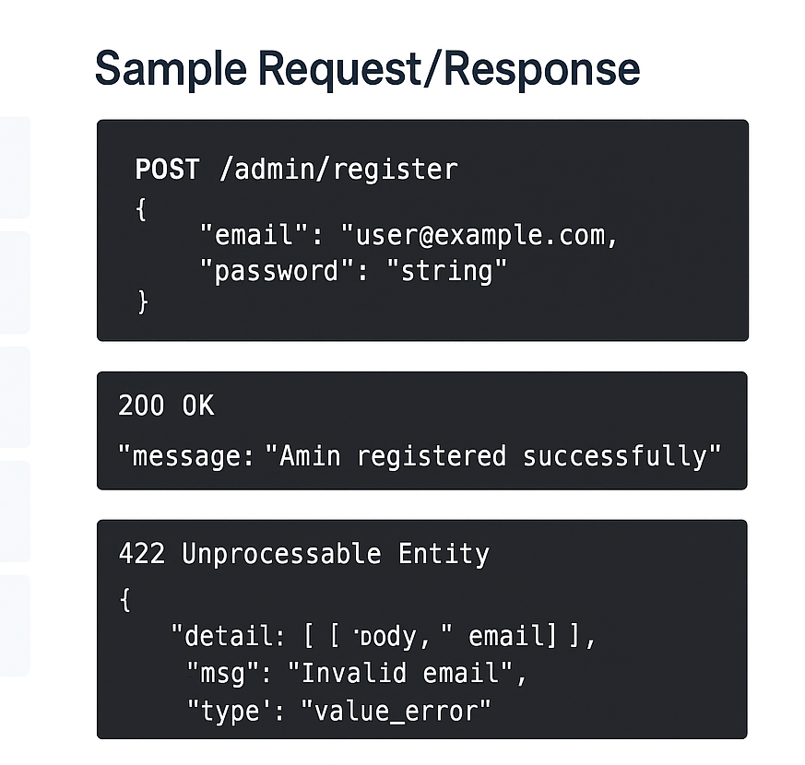
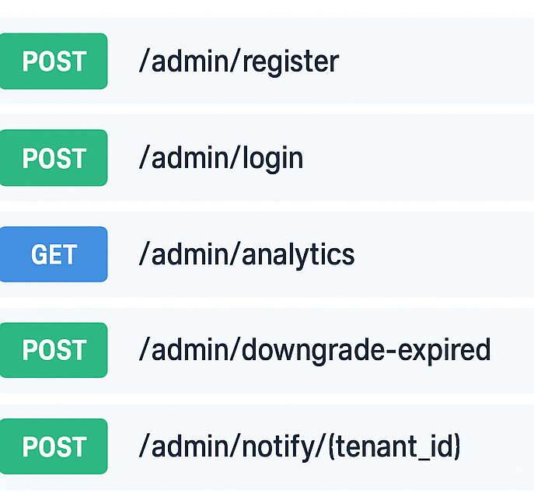
Swagger UI – Admin Endpoints
Admin Endpoints
SaaS Billing & Analytics System

Slide 9
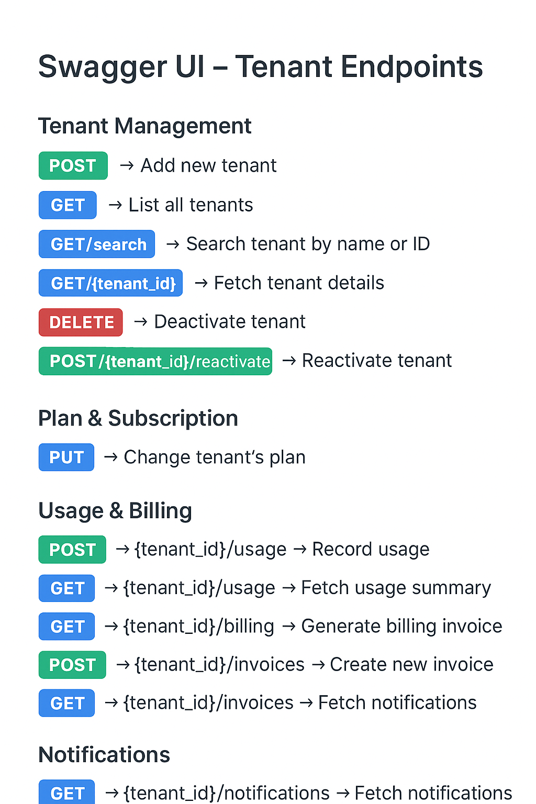
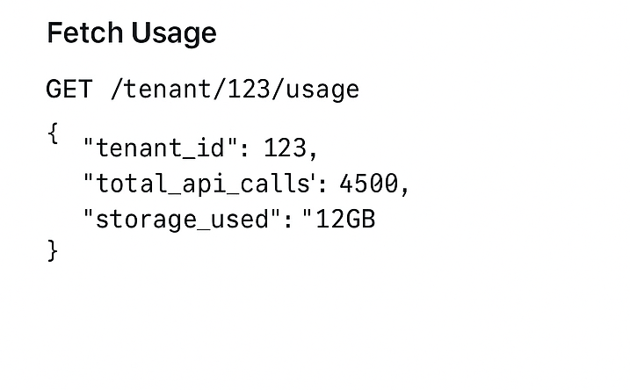
Sample Request/Response
SaaS Billing & Analytics System

Slide 10
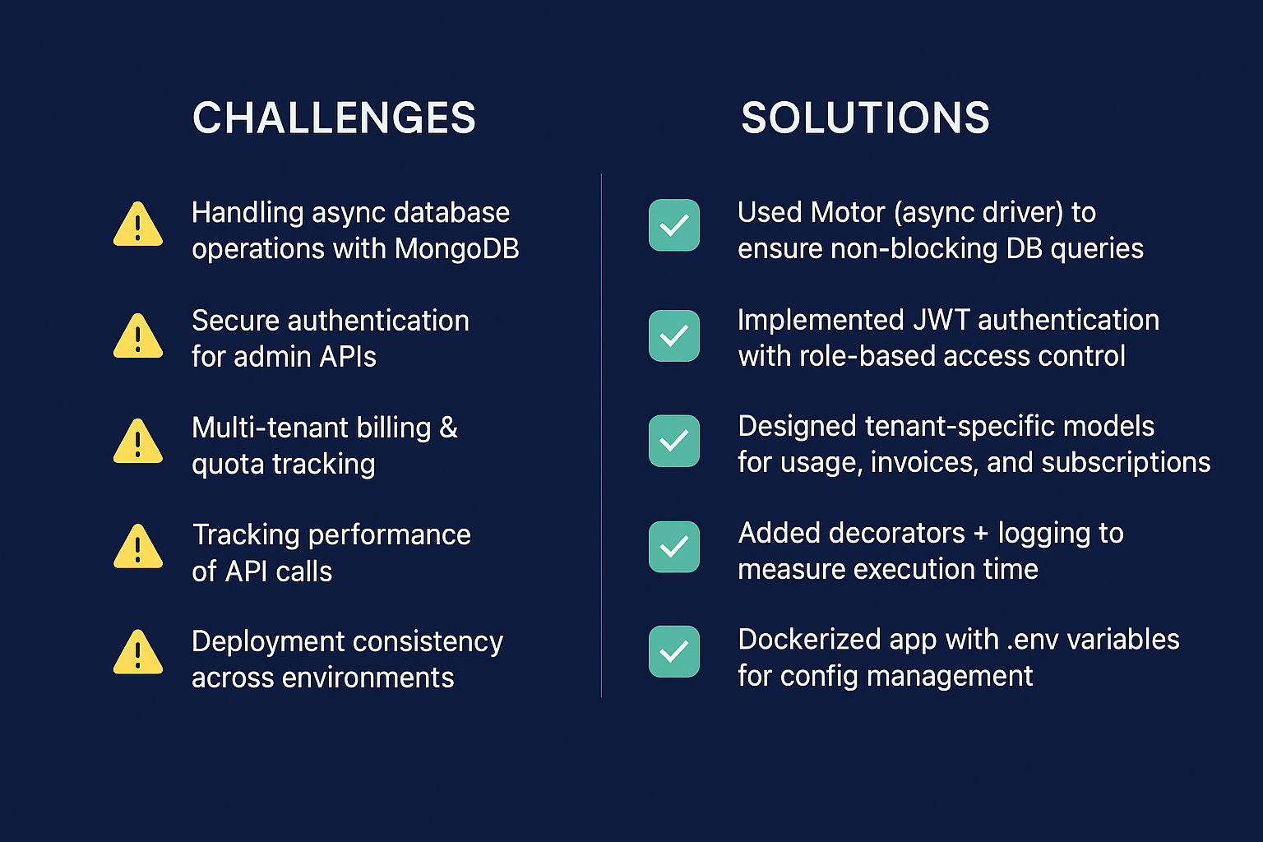
SaaS Billing & Analytics System

Slide 11
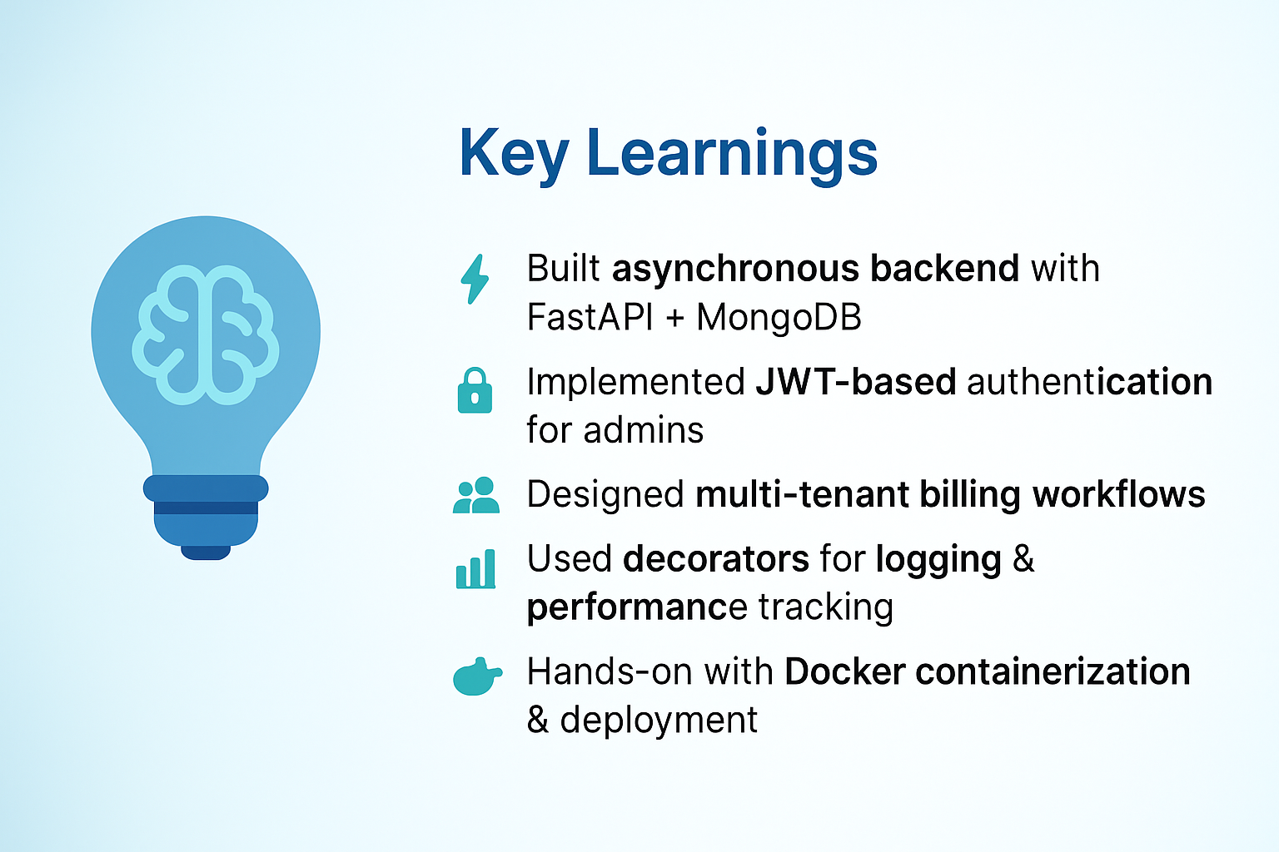
SaaS Billing & Analytics System

Slide 12
Thank You

